Slide 1



Super Bowl Master Doc
Super Bowl LIV Campaign

Slide 2

Overview
Challenges
Develop an aggressive earned media strategy
Leverage the global consumer appeal of Super Bowl LIV
Appeal to clients and prospects

Slide 3
Overview
Solutions
Stick to 3 main media story lines: quality, community and sustainability
Target local, national business and consumer media
Elevate both Sodexo & Centerplate organic social networks through optimized creative assets and channel distribution plans
Reinforce value to client through consumer-friendly digital content strategy
Target client and prospect lists with multiple content A/B tests to establish both a baseline and a reproducible model

Slide 4

Topline Summary
Top 3 Successes to Repeat:
3 Lessons Learned:
Aggressive earned media campaign
Timely social content around a high-profile event
Differentiated story lines to cater to different media outlets and audiences
Instead of B2C2B approach, have distinct B2C and B2B plans
Optimize and design creative assets for social first
Integrate Sales into the content development process

Slide 5


EARNED & SHARED MEDIA
AWARENESS
PAID & ORGANIC SOCIAL
INTEREST
BLOGS & SEO
CONSIDERATION
LANDING PAGE
CONVERSION
CONTACT FORM

Slide 6
EARNED & SHARED MEDIA

Slide 7

Goals
Earned and Shared Media
Command a strong share of voice amidst the overall Super Bowl media landscape
Position Centerplate and Sodexo as industry-leading experts in big-game hospitality
Command a strong rate of preferred messaging pull-through
Leverage photo and video content for visual storytelling and as engaging content for varying social media channels

Slide 8






Media Story Lines
QUALITY
LOCAL IDENTITY & DIVERSITY
SUSTAINABILITY
Culinary & Luxury
Gourmet
Bon Bons
Chef Dayanny
Miami Partners
Aluminum Cups
Food Rescue
Notes:
Art from PDF

Slide 9
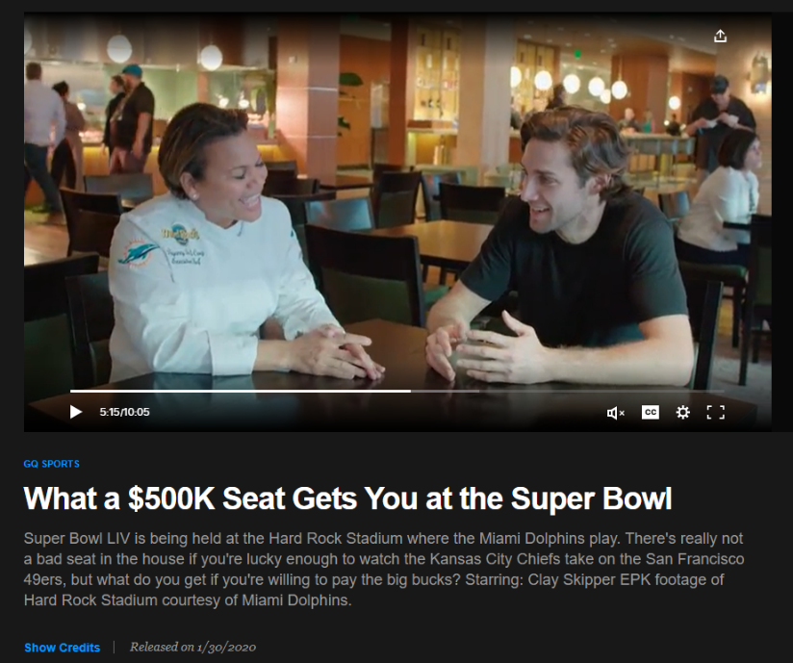
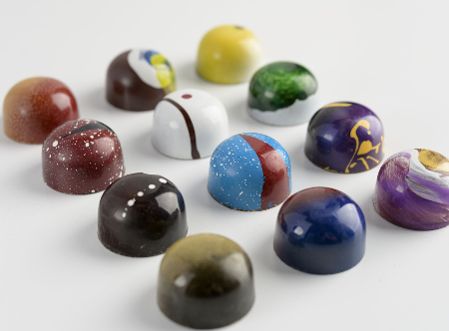
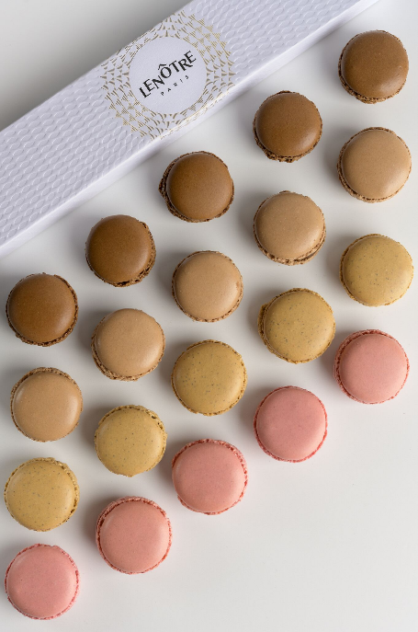
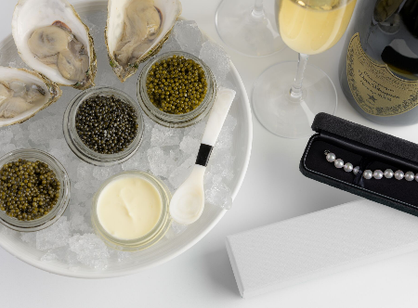

Media Story Lines
Culinary & Luxury

Slide 10



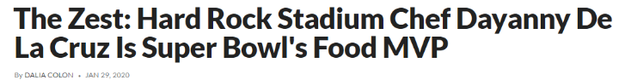

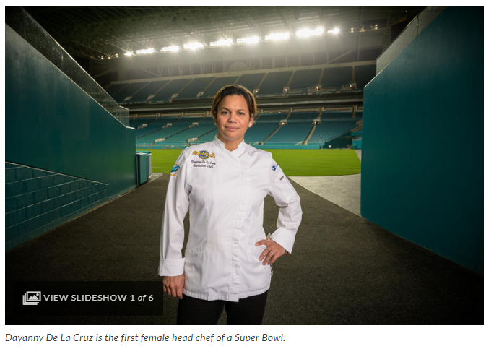
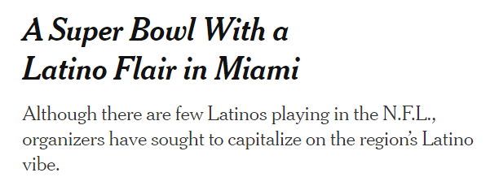
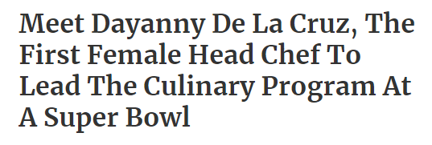
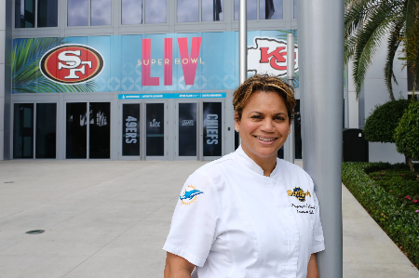

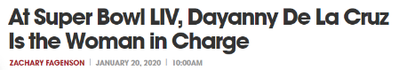
Media Story Lines
Chef Dayanny & Local Flavors

Slide 11

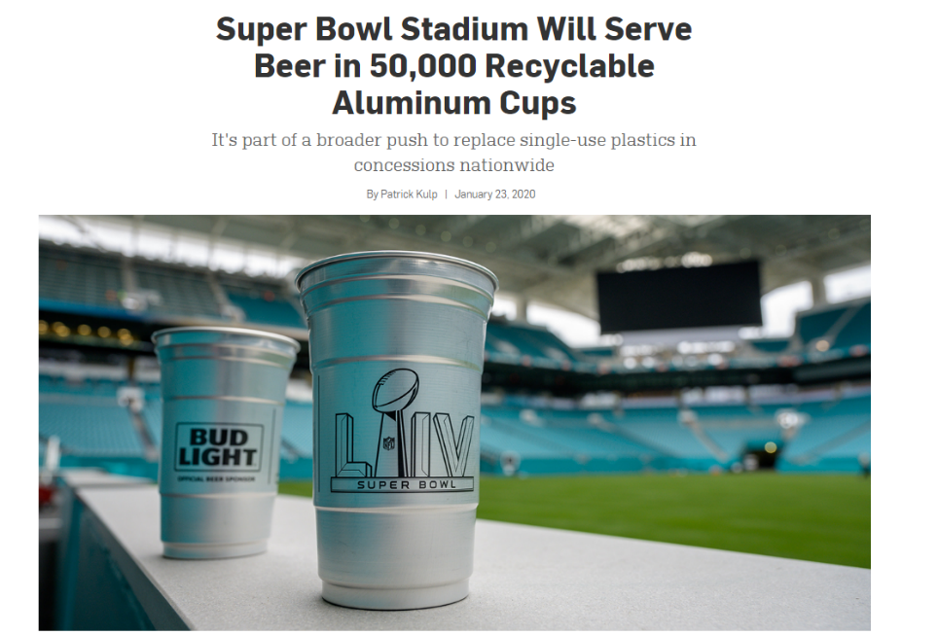

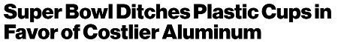

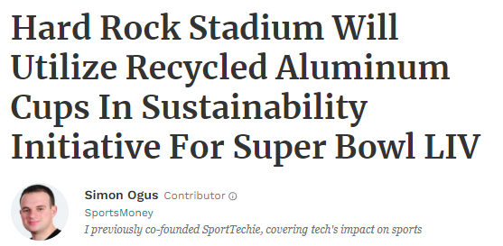
Media Story Lines
Aluminum Cups

Slide 12



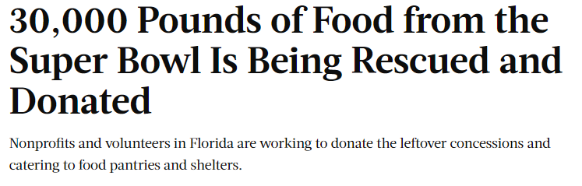
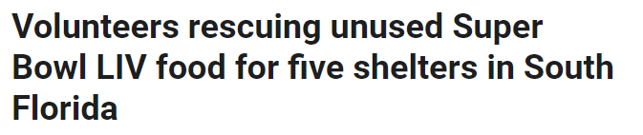
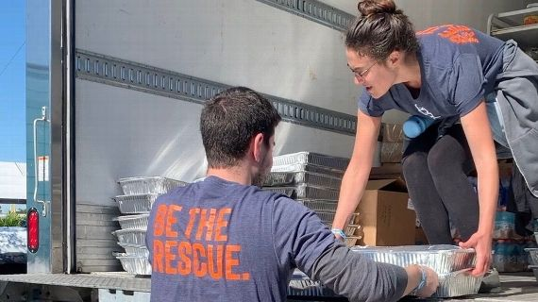

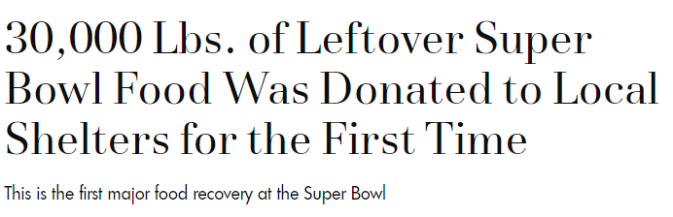
Media Story Lines
Food Recovery

Slide 13
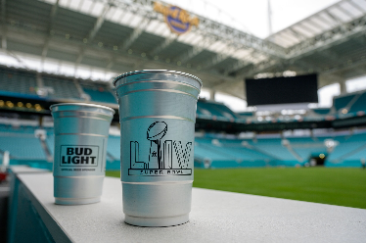
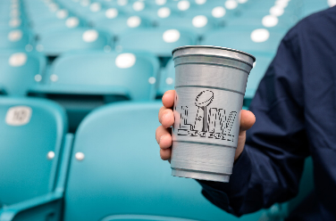
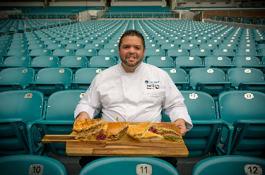
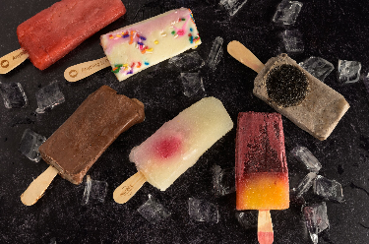
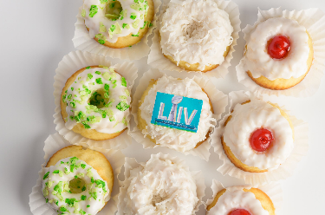
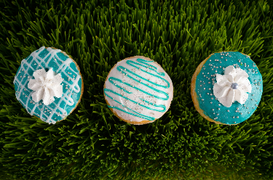
Photography Assets
Used in:
Earned media
Digital assets (social, web)
Pardot emails

Slide 14


Earned Media ROI
IMPRESSIONS
4.53B
INVESTMENT
$26K
400+ media placements
820+ mentions
ROI
+116,538%
AD EQUIVALENCY
$30.3M
$26M broadcast
$4M print & online
$64K blogs

Slide 15
Comparing Campaigns
Readership Impressions
Ad Equivalency
4.53 Billion
$30.3 Million
Super Bowl
Super Bowl
$4.2 Million
2 Million
Starship
Starship

Slide 16
DIGITAL DISTRIBUTION PLAN

Slide 17
Goals
Digital Distribution Plan
Awareness & Engagement
Organic social
Blogs for SEO
Test & learn opportunity
Publish multiple versions of existing assets through paid social to determine most desirable content for B2B targets
Drive traffic to the Super Bowl Landing Page
Cast wide B2C net, but B2B prospects did not filter through the funnel as we had hoped

Slide 18
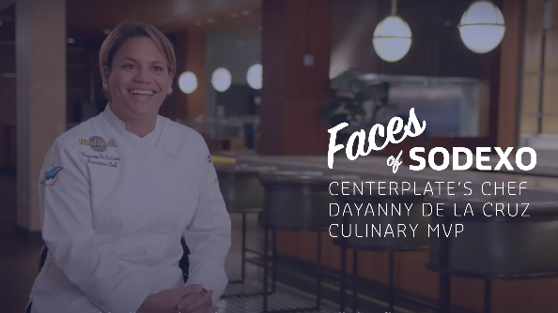
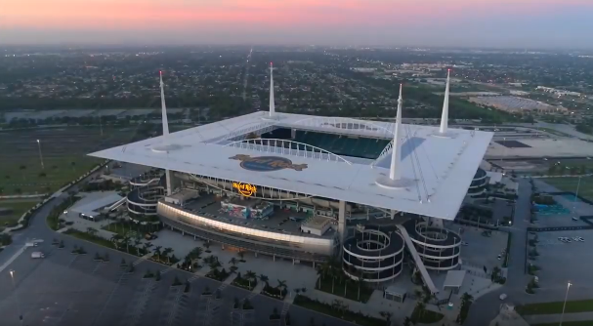
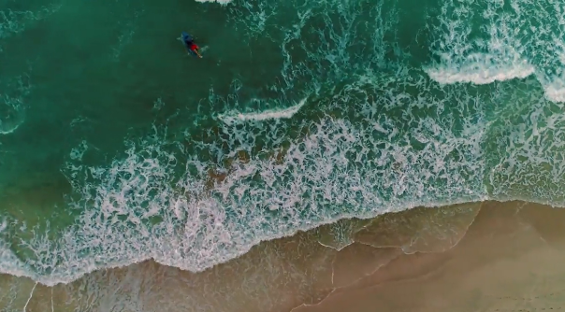

Video Assets
Faces of Sodexo: Chef Dayanny
Hard Rock Stadium
Centerplate
2:28 Faces of Sodexo
0:20 focus on Chef Dayanny
0:45 focus on offers & value
0:20 focus on offers & value
0:10 highlight clip
0:45 highlight clip
Notes:
Faces of Sodexo Video:
TWO VERSIONS
Centerplate's Chef Dayanny de la Cruz: Culinary MVP – used on webpage, Faces of Sodexo page and in blog (2:28)
Chef Dayanny de la Cruz Hosts the Big Game - used in social media campaign (:20 )
Investment = $48K
Video 2:
THREE VERSIONS
Serving up Local Miami Flavors at Hard Rock Stadium – used on webpage(:45)
Focus on Food Partners - used in social media campaign (:20)
Highlights - used in paid social media campaign (:10)
Centerplate video:
Centerplate video (:45) - used on social media
Investment = $15K (includes photography)
All of the original videos are in this Dropbox:
Dropbox Link: https://www.dropbox.com/sh/mzw74g5i4947lfw/AADU37CZH1WbAcmSOMY_ixyLa?dl=0

Slide 19
Digital Distribution Plan
ORGANIC
Owned Social Media
Super Bowl Landing Page
Amplify
Contact Form
Super Bowl Blogs (3)
Earned Media & SEO

Slide 20
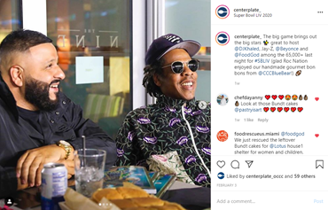
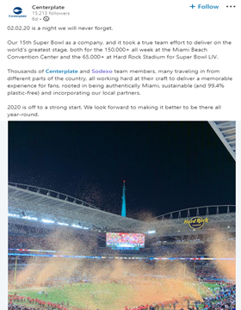
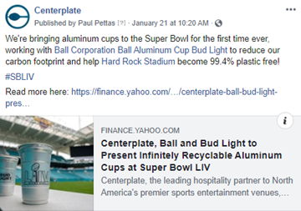
Organic for Centerplate
Across All Channels
7.8K
111K
67
Total Engagements
Total Impressions
Total Posts
Notes:
Scratch channels, leave numbers

Slide 21
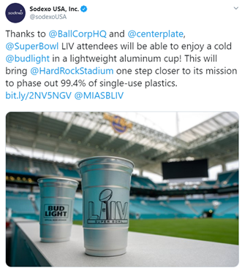
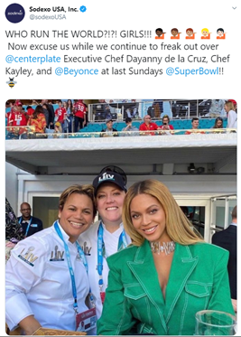
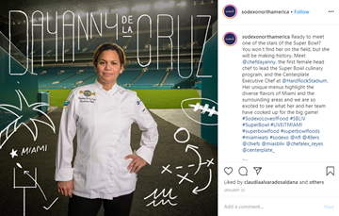
Organic for Sodexo USA
Across All Channels
11K
410K
55
Total Engagements
Total Impressions
Total Posts
Notes:
Scratch channels, leave numbers

Slide 22
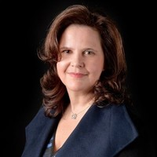
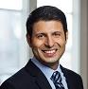
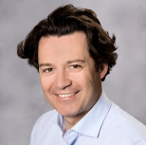
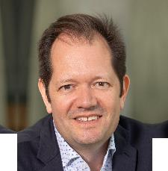
Thought Leadership: Social Media
Total Numbers from Four Executives
64K
4K
55
Total Impressions
Total Engagements
Total
Comments

Slide 23



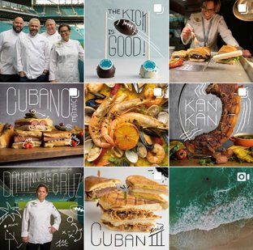
Super Bowl Campaign Month vs. Previous Month
Increased Activity in Sodexo USA’s Owned Social Media Channels
TWITTER
FACEBOOK
INSTAGRAM
Side Note:
47%
359%
343%
Instagram investment in design: $2,500
Increase in Impressions
Increase in Impressions
Increase in Impressions
99%
236%
103%
Increase in Engagements
Increase in Engagements
Increase in Engagements
79%
+3K%
100%
Increase in Post Link Clicks
Increase in Post Link Clicks
Increase in Post Link Clicks

Slide 24

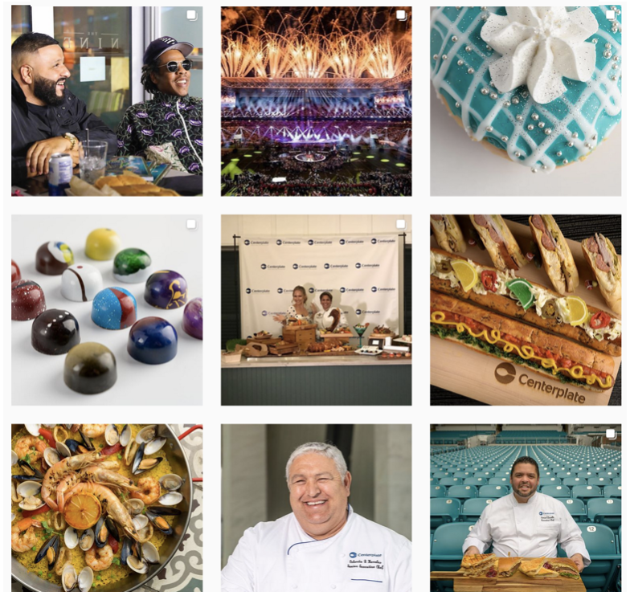
Super Bowl Campaign Month vs. Previous Month
Increased Activity in Centerplate’s Owned Social Media Channels
TWITTER
FACEBOOK
LINKEDIN
149.2%
220%
510%
Increase in Impressions
Increase in Actions
Increase in Shares
90.4K+
200%
80%
Total Monthly Impressions
Increase in Page Likes
Increase in Comments
162%
835%
71%
Increase in Mentions
Post Reach Increase
Increase in Reactions

Slide 25
Organic Social Comparison: Super Bowl LIV vs. Starship
Posts
Engagements
Impressions
55
11.2K
410K
Super Bowl
Super Bowl
Super Bowl
3.3K
11
Starship
43K
Starship
Starship
Notes:
Comparing campaigns

Slide 26
Digital Distribution Plan
PAID
Video A
Test Facebook
Video A
Video B
Super Bowl Landing Page
Video C
Contact Form
Video C
Test LinkedIn
Video D
Video D

Slide 27



Paid Targets
Clients and prospects in Elite and Athletic segmentation
Employees of target Universities for athletic offers
Employees of target major sports leagues
Notes:
Pardot targeting also included people with the following titles:
Food
Dining
Auxiliary
retail
development
operations
Athletic
Sports
Nutrition
Fitness
Physical

Slide 28
Paid Social Results for Facebook and LinkedIn Total
Comparison
Budget | Impressions | Clicks | Average Click-through- rate | Average Cost-per-click
$10,284 $550 | 512,479 47,517 | 2,511 113 | 0.49% 0.24% | $4.09 $4.86
Super Bowl LIV
Faces of Sodexo Gonzaga
Notes:
Channel Budget Impressions Clicks Average CTR Average CPC
LinkedIn $200 10,071 30 0.38% $5.28
Facebook $250 37,446 52 0.14% $4.81
TOTAL $550 47,517 82 0.26% $5.05

Slide 29
Pardot Results
Form Activity
Email: Sustainability
Email: Chef Dayanny
64
405
406
Clicks to View
Emails Delivered
Emails Delivered
0
46%
53%
Marketing Qualified Form Fills
Read Rate
Read Rate
21%
23%
HTML Open Rate
HTML Open Rate
Notes:
Sustainability email: https://pi.pardot.com/email/readReport/id/20993549
Chef Dayanna email: https://pi.pardot.com/email/readReport/id/19362611

Slide 30
BLOGS

Slide 31
Goals
Blogs
Reinforce earned media story lines
SEO
Offer content for "browser" personas to learn more about Sodexo and fulfill various micro-conversions

Slide 32
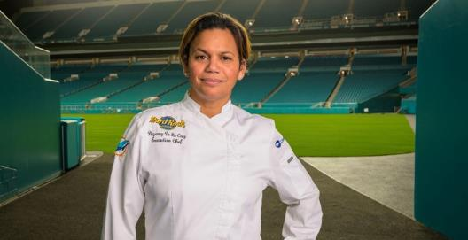
The Culinary MVP for the Big Game
Traffic Sources
110 Referral
65 Direct
48 Organic
1 Social
Top Referrals
57 Sodexo_Net
11 Sodexo.com
9 Facebook
45 Google
224
Previous Page Path
Page Views
113 Super Bowl Landing Page
15 Home
12 Inspired
Thinking
3:28
Average Time on Page
Next Page Path
50 Super Bowl Landing Page
11 All Insights
1 Contact Us
Notes:
https://us.sodexo.com/inspired-thinking/all-insights/the-culinary-mvp-for-the-big-gam.html

Slide 33
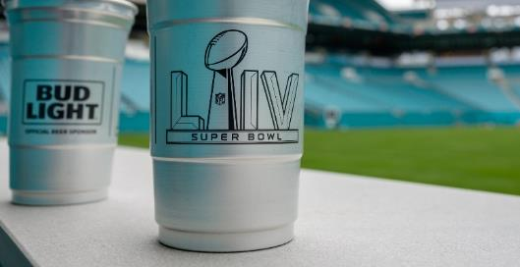

Super Sustainable
Traffic Sources
42 Referral
26 Organic
8 Direct
Top Referrals
26 Google
8 Sodexo_Net
6 Instagram
14 LinkedIn
77
Previous Page Path
Page Views
15 Inspired Thinking
10 Home
12 All Insights
2:03
Average Time on Page
Next Page Path
10 Inspired Thinking
8 All Insights
Notes:
https://us.sodexo.com/inspired-thinking/all-insights/super-sustainable.html

Slide 34
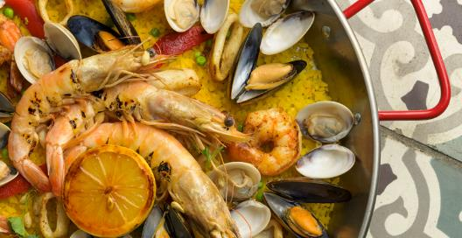
Championship Hospitality for Super Bowl LIV
Traffic Sources
77 Referral
22 Organic
12 Direct
Top Referrals
55 LinkedIn
4 Sodexo_Net
4 Instagram
22 Google
111
Previous Page Path
Page Views
10 All Insights
4 Sports & Leisure
1 Super Bowl Landing Page
1:35
Average Time on Page
Next Page Path
10 Sports & Leisure
3 Super Bowl Landing Page
3 Aluminum Cup PR
Notes:
https://us.sodexo.com/inspired-thinking/all-insights/championship-hospitality-for-sup.html

Slide 35
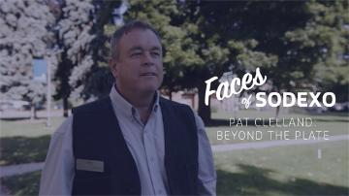
Faces of Sodexo: Gonzaga (Benchmark)
Traffic Sources
47 Organic
32 Referral
29 Direct
Top Referrals
11 Sodexo Careers
44 Google
8
Sodexo.com
7 Sodexo.net
108
Previous Page Path
Page Views
19 Food Services
16 Universities
13 Faces of Sodexo
2:10
Average Time on Page
Next Page Path
9 Home
6 Universities
4
Faces of Sodexo
Notes:
https://us.sodexo.com/about-us/faces-of-sodexo/culinary-mvp.html

Slide 36
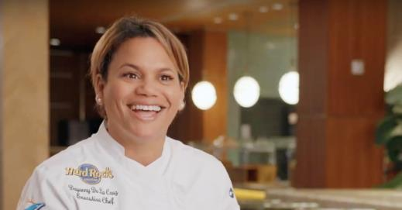
Faces of Sodexo: Chef Dayanny
Traffic Sources
24 Organic
19 Referral
11 Direct
Top Referrals
22 Google
3
sodexo.com
4 Instagram
9 Sodexo_Net
54
Previous Page Path
Page Views
10 Faces of Sodexo
7 Home
2 Super Bowl Landing Page
2:19
Average Time on Page
Next Page Path
6 Faces of Sodexo
5 Home
2 Contact Us
Notes:
https://us.sodexo.com/about-us/faces-of-sodexo/culinary-mvp.html

Slide 37
SEO PERFORMANCE

Slide 38
Organic Search Performance
Between 12/27-1/20
Between 12/27-1/20
Between 1/21-2/14
Sodexo Sports & Leisure Page
All us.sodexo Sites
Super Bowl
Appeared in searches
848
89K
1.7K
6.7%
15.6%
1.9%
Click-through-rate

Slide 39
Organic Search Performance
Super Bowl
Top Searches were for terms related to:
102 Recipes and game day food
49
Chef Dayanny de la Cruz
27
Executive chef or stadium food service hiring
23 Hard Rock Stadium food
“Dayanny de la Cruz”
Term with the highest click-through-rate (11%)
Notes:
Search terms and traffic instead - page is too new for SEO health. Find cut off point somewhere under 50 and add an insights summary

Slide 40
SUPER BOWL
LANDING PAGE

Slide 41
Goals
Super Bowl Landing page
Between 1/21-2/14
Between 1/21-2/14
us.sodexo
Super Bowl
Average Time on Page*
1:38
3:21
Average Exit Rate*
59%
80%
Average Bounce Rate*
68%
76%
Out of Top 10 Visited Pages
#6
*Metrics excluding careers pages

Slide 42
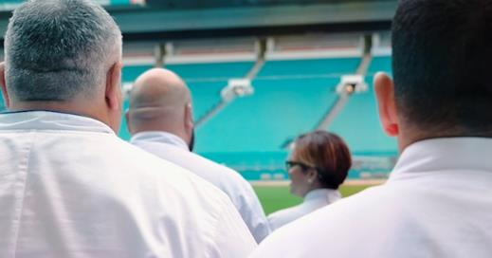
Super Bowl Landing Page
Traffic Sources
1285 Referral
986 Direct
232 Organic
17 Social
Top Referrals
1166 Facebook
643 Sodexo_Net
216
Google
185 LinkedIn
3.5K
Previous Page Path
Page Views
183
Home
51 Culinary MVP Blog
27 Sports
& Leisure
3:21
Average Time on Page
Next Page Path
120 Our Team
117 Culinary MVP Blog
17 Sports & Leisure Contact
11 Contact Us
Notes:
https://us.sodexo.com/industry/sports-leisure/working-the-big-game-2020.html
4th most visited non-careers page on us.sodexo.com with 3,521 pageviews
Average Time on Page: 3:21 seconds, 105% increase over benchmark
Bounce Rate: 76%, 11% increase over benchmark
Exit Page: 80%, 26% increase over benchmark

Slide 43
ROI for Blog and Landing Page
Investment: $3,380 for building pages
4K
429
Page views
Conversions*
(completed call-to-actions)
$0.85
$7.87
Per page view
Per conversion
*Incl. Total video starts and clicks
Notes:
https://us.sodexo.com/industry/sports-leisure/working-the-big-game-2020.html

Slide 44
Spending and ROI Summary
SPENDING
ROI
$4.5B
22.6K
$107K
Earned Media Impressions
Organic Social Media Engagements
Total Spending
4K
Photography
Earned Media
Video
Landing Pages & Infographic
Blogs
Sarosh Post
Instagram
Social paid
Website Views on Super Bowl Pages
2.5K
1.7K
Clicks through paid social media placements
Organic Search Appearances

Slide 45
APPENDIX

Slide 46




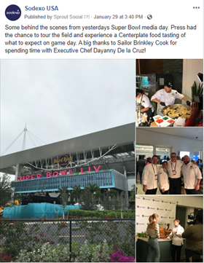
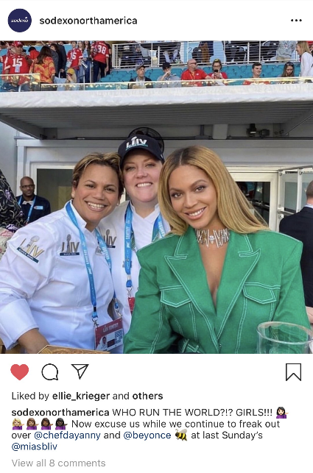
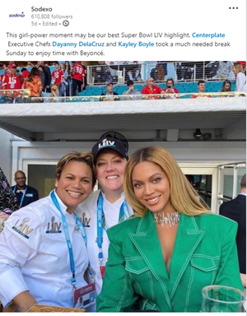
Top Performing Post Per Channel - Sodexo USA
125.7K
2.8K
7.9K
300
106K
2.2K
2.4K
269
Impressions
Engagement
Impressions
Engagement
Impressions
Engagement
Impressions
Engagement
Notes:
Owned

Slide 47
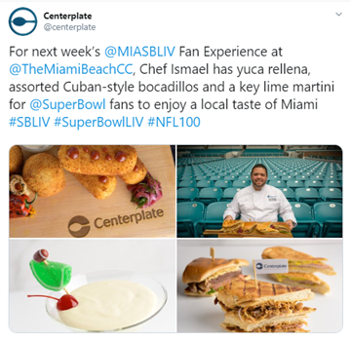
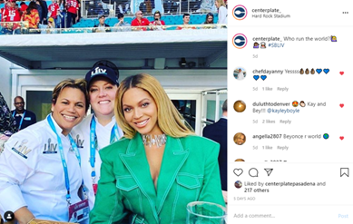
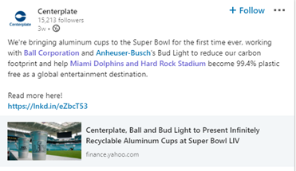
Top Performing Post Per Channel - Centerplate
2.7K
184
10.3K
2.9K
17.9K
447
x
223
Impressions
Engagement
Impressions
Engagement
Impressions
Engagement
Impressions
Engagement
Notes:
Owned

Slide 48



Nathalie Bellon
Organic for Executive Posts
Super Bowl Post
Super Bowl Thread
1.6K Impressions
24K Views
162 Engagements
471 Reactions
28 Likes
23 Comments
2 RT
Behind the Scene
Behind the Scene
1.3K Impressions
2.9K Views
48 Engagements
67 Reactions
13 Likes
1 Comment
1 RT
Notes:
SuperBowl post: https://www.linkedin.com/posts/nathalie-bellon-szabo_superbowl-activity-6630111129391759360-zIeA
Behind the scene: https://www.linkedin.com/posts/nathalie-bellon-szabo_dancing-dining-and-stars-sheinelle-tours-activity-6629084618576531456-F0u1
Behind the scene: https://twitter.com/NBellonSzabo/status/1223317450378432513?s=20
SuperBowl thread: https://twitter.com/NBellonSzabo/status/1224343057212022786?s=20

Slide 49



Sarosh Mistry
Organic for Executive Posts
First Female Chef
Give Back to Communities
18K Views
5K Views
649 Reactions
164 Reactions
28 Comments
11 Comments
Centerplate’s Culinary MVP
3.5K Views
95 Reactions
6 Comments
Notes:
Super Bowl’s First Female Executive Chef: Bring It On (Venues Now share): https://www.linkedin.com/posts/saroshmistry_super-bowls-first-female-executive-chef-activity-6626536858857861120-8xGf
Centerplate’s Chef Dayanny de la Cruz: Culinary MVP (long video shared): https://www.linkedin.com/posts/saroshmistry_centerplates-chef-dayanny-de-la-cruz-culinary-activity-6628271573713383425-qEmJ
Yes! Chef Dayanny DelaCruz: "Our Centerplate team is proud to give back to the communities we serve.” (Western Journal Food donation story shared) https://www.linkedin.com/posts/saroshmistry_30000-lbs-of-uneaten-food-from-super-bowl-activity-6633038829752250369-UGAE

Slide 50

Satya Menard
Organic for Executive Posts
Congratulations to Chef Dayanny
8.6K Views
294 Reactions
11 Comments
Notes:
Congratulations to Executive Chef Dayanny:
https://www.linkedin.com/posts/satya-christophe-menard-a70b3923_congratulations-to-executive-chef-dayanny-activity-6630254171608096768-N_Sx

Slide 51



Steve Pangburn
Organic for Executive Posts
Aluminum Cups
Great Success
3K Views
4.7K Views
124 Reactions
1464 Reactions
6 Comments
6 Comments
Stadium Hosting
2.4K Views
62 Reactions
3 Comments
Notes:
We’re bringing aluminum cups to the Super Bowl (Yahoo story share): 3180 views 124 reactions, 6 comments
https://www.linkedin.com/posts/steve-pangburn-24249b136_centerplate-ball-and-bud-light-to-present-activity-6625429405583884289-QHQX
A look inside the stadium hosting the Super Bowl (CNN story share): 2407 views, 62 reactions, 3 comments
https://www.linkedin.com/posts/steve-pangburn-24249b136_a-look-inside-the-stadium-hosting-super-bowl-activity-6626894747996876800-I90g
Super Bowl LIV was a great success:
https://www.linkedin.com/posts/steve-pangburn-24249b136_super-bowl-liv-was-a-great-success-thanks-activity-6630544109570441217-Uxuy

